Slide 1
JavaScript Building Blocks
Working with Variables, Data Types, and Functions

Slide 2
Learning Objectives
Get acquanted with case sensitivity in JavaScript
Demonstrate how to make JavaScript code mode readable
Be able to write JavaScript code that involves use of variables, data types, and functions to organize the code

Slide 3
Preliminaries
Case Sensitivity in JavaScript
JavaScript is case sensitive
Within JavaScript code:
  Object names must always be all lowercase (e.g., document)
  Method/function names must always be the way they are defined {e.g., myFunction(), getElementById() }

Slide 4
Preliminaries
Adding Comments to a JavaScript Program
Comments
  Nonprinting lines placed in code containing various types of remarks
Line comment
  Hides a single line of code
  Add two slashes // before the comment text
Block comments
  Hide multiple lines of code
  Add /* before the first character included in the block and */ after the last character in the block

Slide 5
Using Variables
Variables
  Values a program stores in computer memory
Assigning a value to a variable
  Same as storing a value in a variable

Slide 6
Assigning Variable Names
Identifier
  Name assigned to a variable
Rules and conventions
  Must begin with an uppercase or lowercase ASCII letter, dollar sign ($), or underscore ( _ )
  Can use numbers in an identifier: not as the first character
  Cannot include spaces in an identifier
  Cannot use reserved words for identifiers
Reserved words (keywords)
  Special words: part of the JavaScript language syntax

Slide 7
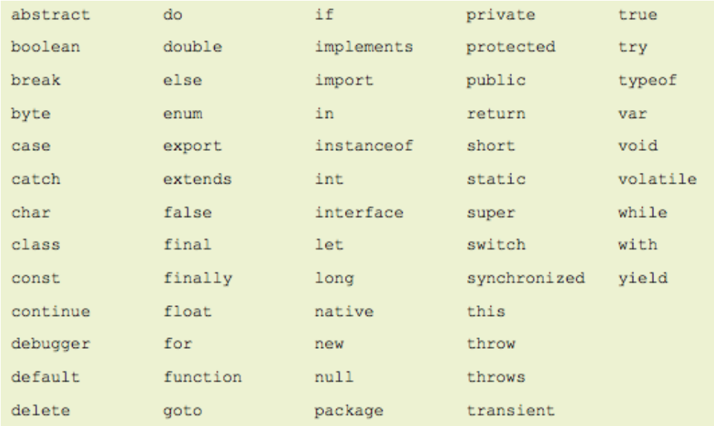
Assigning Variable Names (cont’d.)
JavaScript Reserved Keywords

Slide 8
Assigning Variable Names (cont’d.)
Declaring and initializing variables
Use reserved keywords var, let and const to create variables
  Example: var curTime;
  Note: JavaScript is weakly-typed; hence you do not include data type when declaring variables
Initialize variable using the following syntax:
  var variable_name = value;
Assignment operator: equal sign (=)
  Assigns value on the right side of the expression to the variable on the left side of the expression
Assigning a literal string value to a variable
  Enclose text in quotation marks
Can assign the value of one variable to another

Slide 9
Assigning Variable Names (cont’d.)
var declarations are globally scoped or function scoped while let and const are block scoped.
var variables can be updated and re-declared within its scope; let variables can be updated but not re-declared; const variables can neither be updated nor re-declared.
variables are all hoisted to the top of their scope; but while var variables are initialized with undefined, let and const
  variables are not initialized.
While var and let can be declared without being initialized, const must be initialized during declaration.

Slide 10
Assigning Variable Names (cont’d.)
Displaying variables (Do not enclose it in quotation marks)
Pass variable name to document.write() method or innerHTML property (or value property for form inputs). You could also use alert() global method of the Window object
Could also use console.log() method to display the result in the console.
Modifying variables
Change a variable’s value at any point in a script

Slide 11
Building Expressions
Expression
Literal value or variable or a combination of literal values, variables, operators, and other expressions
  Evaluated by JavaScript interpreter to produce a result
Operands
Variables and literals contained in an expression
Literal
Value such as a literal string or a number
Operators
Symbols used in expressions to manipulate operands
https://www.w3schools.com/jsref/jsref_operators.asp

Slide 12
Working with Functions
Methods
  Procedures associated with an object
Functions
  Related group of JavaScript statements
  Executed as a single unit
  Virtually identical to methods
  Not associated with an object
  Must be contained within a script element

Slide 13
Defining Functions
Named function
  Related statements assigned a name
  Call, or reference, named function to execute it
Anonymous function
  Related statements with no name assigned
  Work only where they are located in code
Use named function when you want to reuse code
Use anonymous function for code that runs only once

Slide 14
Defining Functions (cont'd.)
Function definition
  Lines making up a function
Named function syntax
  function name_of_function(parameters) {
  statements;
  }
Anonymous function syntax
  function (parameters) {
  statements;
  }

Slide 15
Defining Functions (cont'd.)
Parameter
  Variable used within a function
  Placed within parentheses following a function name
  Multiple parameters allowed
    calculateVolume(length, width, height)
Note: functions may or may not have parameters

Slide 16
Defining Functions (cont'd.)
Function Statements
  Do the actual work
  Contained within function braces
Calling Functions
  To execute a named function:
    Must invoke, or call, it
  Function call
    Code calling a function
    Consists of function name followed by parentheses
    Contains any variables or values assigned to the function parameters

Slide 17
Self-Invoking Functions
Function expressions can be made "self-invoking".
A self-invoking expression is invoked (started) automatically, without being called.
Function expressions will execute automatically if the expression is followed by ().
Yopau have to add rentheses around the function to indicate that it is a function expression.

Slide 18
Understanding Variable Scope
Variable scope
  Where in code a declared variable can be used
Global variable
  Declared outside a function
  Available to all parts of code
Local variable
  Declared inside a function
  Only available within the function in which it is declared
  Cease to exist when the function ends
  Keyword var required

Slide 19
Understanding Variable Scope (cont’d.)
Good programming technique
  Always use the var keyword when declaring variables
    Clarifies where and when variable used
Poor programming technique
  Declaring a global variable inside of a function by not using the var keyword
    Harder to identify global variables in your scripts

Slide 20
Understanding Variable Scope (cont’d.)
If variable declared within a function and does not include the var keyword
  Variable automatically becomes a global variable
Program may contain global and local variables with the same name
  Local variable takes precedence
  Value assigned to local variable of the same name
    Not assigned to global variable of the same name

Slide 21
Summary
Variables
  Variables in JavaScript are declared using the var keyword
  JavaScript is a weakely-typed language (i.e., you do not need to explicitly state variable's data type when declaring it)
Functions
  Similar to methods
  Pass parameters
  To execute, must be called or made self-evoking

Slide 22
Summary (cont'd)
Variable scope
  Where a declared variable can be used
  Global and local variables
Data type
  Specific category of information a variable contains
  Static typing and dynamic typing

Slide 23
Summary (cont'd)
Data Types
  Numeric data types: integer and floating point
  Boolean values: true and false
  Strings: one or more character surrounded by double or single quotes

Slide 24
References
Gosselin, D. and Vodnik, S. (2015). JavaScript, 6th Ed.
Haverbeke, M. (2014). Eloquent JavaScript
(http://eloquentjavascript.net/Eloquent_JavaScript.pdf)
http://www.w3schools.com/js/js_functions.asp

